Slide 1
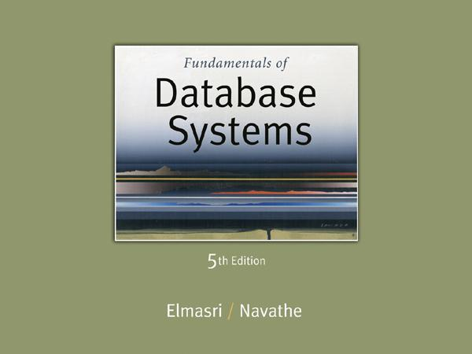
Slide 8- 1
Notes:
1

Slide 2
DCL COMMANDS

Slide 3
DCL COMMANDS
DCL includes commands such as GRANT and REVOKE which mainly deal with the rights, permissions, and other controls of the database system.
Syntax:
GRANT privileges_names ON object TO user;
Parameters Used:
privileges_name: These are the access rights or privileges granted to the user.
object: It is the name of the database object to which permissions are being granted. In the case of granting privileges on a table, this would be the table name.
user: It is the name of the user to whom the privileges would be granted.

Slide 4
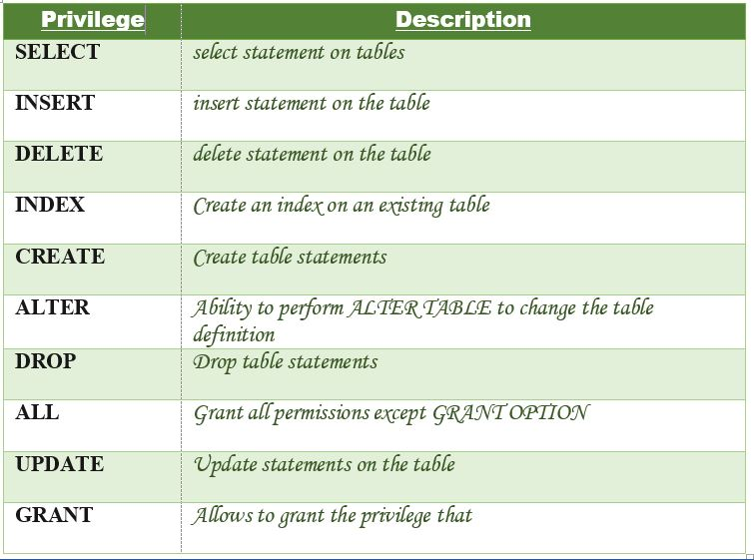
Privileges:

Slide 5
Different ways of granting privileges to the users:
Granting SELECT Privilege to a User in a Table:
To grant Select Privilege to a table named “users” where User Name is Amit, the following GRANT statement should be executed.
GRANT SELECT ON Users TO'Amit'@'localhost;
Granting more than one Privilege to a User in a Table:
To grant multiple Privileges to a user named “Amit” in a table “users”, the following GRANT statement should be executed.
GRANT SELECT, INSERT, DELETE, UPDATE ON Users TO ‘Amit'@'localhost;

Slide 6
Granting All the Privilege to a User in a Table:
To Grant all the privileges to a user named “Amit” in a table “users”, the following Grant statement should be executed.
GRANT ALL ON Users TO 'Amit'@'localhost;
Granting a Privilege to all Users in a Table:
To Grant a specific privilege to all the users in a table “users”, the following Grant statement should be executed.
GRANT SELECT ON Users TO '*'@'localhost;
In the above example the “*” symbol is used to grant select permission to all the users of the table “users”.

Slide 7
Revoke command
Revoke command withdraw user privileges on database objects if any granted.
It does operations opposite to the Grant command.
When a privilege is revoked from a particular user U, then the privileges granted to all other users by user U will be revoked.
Syntax:
REVOKE privileges ON object FROM user;

Slide 8
Example:
grant insert,
select on accounts to Ram
By the above command user ram has granted permissions on accounts database object like he can query or insert into accounts.
revoke insert,
select on accounts from Ram
By the above command user ram’s permissions like query or insert on accounts database object has been removed.

Slide 9
Aliases and DISTINCT
Aliases
In SQL, we can use the same name for two (or more) attributes as long as the attributes are in different relations
Aliases are the temporary names given to tables or columns for the purpose of a particular SQL query.
It is used when the name of a column or table is used other than its original name, but the modified name is only temporary.
Slide 8- 9
Notes:
9

Slide 10
Alias cntd…
Aliases are created to make table or column names more readable.
The renaming is just a temporary change and the table name does not change in the original database.
Aliases are useful when table or column names are big or not very readable.
These are preferred when there is more than one table involved in a query.

Slide 11
ALIASES
Some queries need to refer to the same relation twice
In this case, aliases are given to the relation name
Query 1: For each employee, retrieve the employee's name, and the name of his or her immediate supervisor. Q1: SELECT E.FNAME, E.LNAME, S.FNAME, S.LNAME FROM EMPLOYEE E S WHERE E.SUPERSSN=S.SSN
In Q1, the alternate relation names E and S are called aliases or tuple variables for the EMPLOYEE relation
We can think of E and S as two different copies of EMPLOYEE; E represents employees in role of supervisees(employee) and S represents employees in role of supervisors
Slide 8- 11
Notes:
11

Slide 12
Syntax for Column Alias
SELECT column as alias_name FROM table_name;
column: fields in the table
Column Alias
Example:
SELECT CustomerID AS SSN FROM Customer;

Slide 13
Table Alias
Generally, table aliases are used to fetch the data from more than just a single table and connect them through field relations.
To fetch the CustomerName and Country of the customer with Age = 21.
Example:
SELECT s.CustomerName, d.Salary
FROM Customer AS s, Department
AS d WHERE s.Age=21 AND
s.DNO=d.DNO;

Slide 14
USE OF DISTINCT
SQL does not treat a relation as a set; duplicate tuples can appear
To eliminate duplicate tuples in a query result, the keyword DISTINCT is used
For example, the result of Q11 may have duplicate SALARY values whereas Q11A does not have any duplicate values Q11: SELECT SALARY FROM EMPLOYEE
Q11A: SELECT DISTINCT SALARY FROM EMPLOYEE
Slide 8- 14
Notes:
14

Slide 15
ANY Operator
The ANY operator is used to verify if any single record of a query satisfies the required condition.
This operator returns a TRUE, if the given condition is satisfied for any of the values in the range.
If none of the values in the specified range satisfy the given condition, this operator returns false.
You can also use another query (subquery) along with this operator.

Slide 16
Syntax
Column_name operator ANY (subquery);
column_name is the name of a column in the main query.
operator is a comparison operator such as =, <, >, <=, >=, or <>.
subquery is a SELECT statement that returns a single column of values.

Slide 17
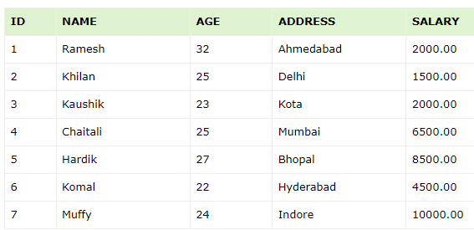
Example:
Consider the CUSTOMERS table which contains the personal details of customers including their name, age, address and salary etc.

Slide 18
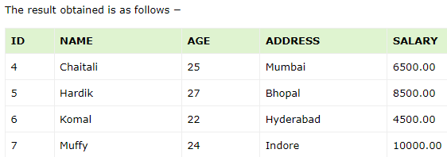
list out the details of all the CUSTOMERS whose SALARY is greater than the SALARY of any customer whose AGE is 32.
SELECT * FROM CUSTOMERS WHERE SALARY > ANY (SELECT SALARY FROM CUSTOMERS WHERE AGE = 32);

Slide 19
ALL Operator
The SQL ALL operator returns all the records of the SELECT statement.
It returns TRUE if the given condition is satisfied for ALL the values in the range.
It always returns a Boolean value.
It is used with SELECT, WHERE and HAVING statements in SQL queries.
The data type of the values returned from a subquery must be the same as the outer query expression data type.

Slide 20
Syntax:
Column_name operator ALL (subquery);
Example
The details of all the customers whose salary is not equal to the salary of any customer whose age is 25
SELECT * FROM CUSTOMERS WHERE SALARY <> ALL (SELECT SALARY FROM CUSTOMERS WHERE AGE = 25);

Slide 21
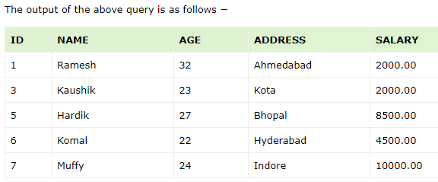

Slide 22
Views
Views is a virtual table.
A view can represent a subset of a real table, selecting certain columns or certain rows from an ordinary table.
A view can even represent joined tables.
Because views are assigned separate permissions, you can use them to restrict table access so that the users see only specific rows or columns of a table.
A view can be created from one or many tables

Slide 23
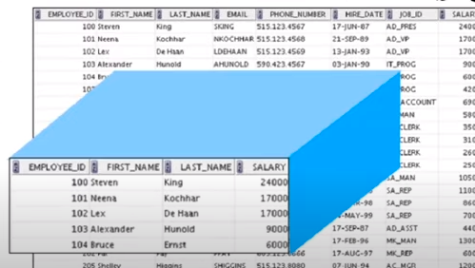
View

Slide 24
Creating view
The PostgreSQL views are created using the CREATE VIEW statement.
The PostgreSQL views can be created from a single table, multiple tables, or another view.
CREATE [TEMP|TEMPORARY] VIEW view_name
AS SELECT column1, column2.....
FROM table_name
WHERE [condition];
If the optional TEMP or TEMPORARY keyword is present, the view will be created in the temporary space.
Temporary views are automatically dropped at the end of the current session

Slide 25
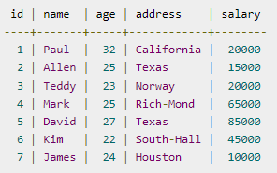
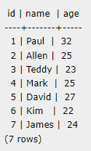
Example
CREATE VIEW COMPANY_VIEW
AS SELECT ID, NAME, AGE
FROM COMPANY;
SELECT * FROM COMPANY_VIEW;
This would produce the following result −

Slide 26
Dropping Views
Obviously, where you have a view, you need a way to drop the view if it is no longer needed.
The syntax is very simple and is given below −
DROP VIEW view_name;
Following is an example to drop the CUSTOMERS_VIEW from the CUSTOMERS table.
DROP VIEW CUSTOMERS_VIEW;

Slide 27
Advantages of PostgreSQL views
1) Simplifying complex queries
Views help simplify complex queries.
Typically, you first create views based on complex queries and store them in the database.
Then, you can use simple queries based on views instead of using complex queries.
2) Security and access control
You can create views that expose subsets of data in the base tables, hiding sensitive information.
This is particularly useful when you have applications that require access to distinct portions of the data.
3) Logical data independence
If your applications use views, you can freely modify the structure of the

Slide 28
Updating a View
A view can be updated under certain conditions which are given below −
The SELECT clause may not contain the keyword DISTINCT.
The SELECT clause may not contain summary functions.
The SELECT clause may not contain set functions.
The SELECT clause may not contain set operators.
The SELECT clause may not contain an ORDER BY clause.
The FROM clause may not contain multiple tables.
The WHERE clause may not contain subqueries.
The query may not contain GROUP BY or HAVING.
Calculated columns may not be updated.
All NOT NULL columns from the base table must be included in the view in order for the
INSERT query to function.

Slide 29
Inserting Rows into a View
Rows of data can be inserted into a view. The same rules that apply to the UPDATE
command also apply to the INSERT command.
Here, we cannot insert rows in the CUSTOMERS_VIEW because we have not included all the NOT NULL columns in this view, otherwise you can insert rows in a view in a similar way as you insert them in a table.
Deleting Rows into a View
Rows of data can be deleted from a view. The same rules that apply to the UPDATE and INSERT commands apply to the DELETE command.
Following is an example to delete a record having AGE = 22.
SQL > DELETE FROM CUSTOMERS_VIEW WHERE age = 22;
This would ultimately delete a row from the base table CUSTOMERS and the same would reflect in the view itself

Slide 30
Dropping Views
Obviously, where you have a view, you need a way to drop the view if
it is no longer needed. The syntax is very simple and is given below −
DROP VIEW view_name;
Following is an example to drop the CUSTOMERS_VIEW from the CUSTOMERS table.
DROP VIEW CUSTOMERS_VIEW;

Slide 31
Creating View from multiple tables
View from multiple tables can be created by simply include multiple tables in the SELECT statement.
In the given example, a view is created named MarksView from two tables
Student_Detail and Student_Marks.
Syntax:
CREATE VIEW view_name AS
SELECT table1.col_name1, table1.col_name2,table2.col_name1 FROM table1,table2
WHERE table1.col_name = Table2.col_name; (matching column)
Example:
CREATE VIEW MarksView AS
SELECT Student_Detail.NAME, Student_Detail.ADDRESS, Student_Marks.MARKS FROM Student_Detail, Student_Mark
WHERE Student_Detail.NAME = Student_Marks.NAME;

Slide 32
Assertion
An assertion is a constraint or condition that must always be true for the database to remain in a consistent state.
Assertions are used to enforce business rules, integrity constraints, or any other conditions that the database administrator deems necessary for the data to be valid and meaningful.
Example:
For example, suppose you have a database for a library management system.
You might have an assertion that ensures that the total number of copies of a book available in the library cannot be negative.
This assertion would be enforced whenever a new copy is added or removed from the library.

Slide 33
In SQL, assertions can be declared using the CREATE ASSERTION statement.
However, not all database systems support assertions directly.
Some databases provide alternative mechanisms for enforcing constraints, such as triggers, check constraints, or stored procedures.

Slide 34
Example
Suppose we have a table "Orders" and we want to ensure that the total amount of all orders is always less than 10000.
CREATE ASSERTION orders_total CHECK ((SELECT SUM(amount) FROM Orders) < 10000); SQL
This assertion ensures that the total amount of all orders will never exceed 10000.
If an attempt is made to add an order that would cause the total to exceed 10000, the database system will reject it.

Slide 35
PL /SQL-
Cursor
Function
Procedures
Triggers

Slide 36
Cursor:
In DBMS, a cursor is a database object used to retrieve or manipulate data row by row, especially when dealing with result sets that consist of multiple rows.
Think of it like a pointer or a reference to a specific row within a result set.
Cursors are particularly useful when you need to work with data sequentially, process one row at a time,
or when you need to perform operations that can't be easily accomplished with set-based operations.

Slide 37
There are generally two types of cursors:
Implicit Cursor:
Automatically created by the DBMS for SQL statements like SELECT, INSERT, UPDATE, or DELETE.
Implicit cursors are managed by the DBMS internally, and you don't need to explicitly declare or control them in your code.
Explicit Cursor:
Created explicitly by the programmer using the DECLARE CURSOR statement.
Explicit cursors provide more control over the result set traversal, allowing the programmer to open, fetch, and close the cursor as needed.

Slide 38
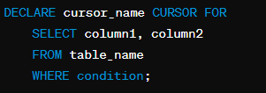
Explicit cursors
Explicit cursors in database management systems (DBMS) are programmatically created and managed by the developer to retrieve data row by row from a result set.
1. Declaration:
First, you declare the cursor using the DECLARE CURSOR statement. This statement defines the SQL query that the cursor will use to fetch data.

Slide 39

2. Opening the Cursor:
After declaring the cursor, you need to open it using the OPEN statement. This step initializes the cursor and executes the SQL query, populating the result set.
3. Fetching Rows:
Once the cursor is opened, you can fetch rows from the result set one by one using the FETCH statement. This retrieves the next row of data from the result set and advances the cursor position.

Slide 40
4. Processing Rows:
After fetching a row, you can perform operations or calculations using the retrieved data. This step allows you to apply business logic or perform calculations on a row-by-row basis.
5. Closing the Cursor:
Once you've finished processing all the rows, or when you no longer need the cursor, you should close it using the CLOSE statement. This releases the resources associated with the cursor.
CLOSE cursor_name;

Slide 41
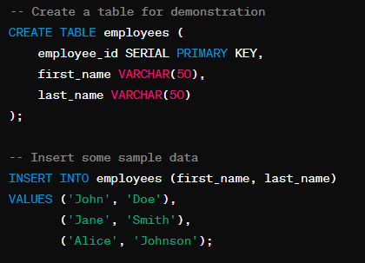
Example

Slide 42
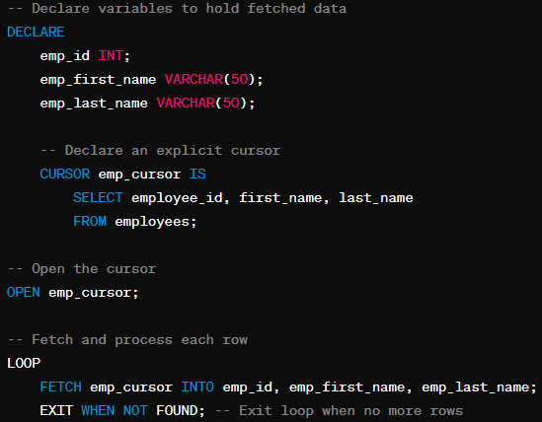
-- Declare the cursor
DECLARE ecsr CURSOR FOR SELECT eid FROM emp;

Slide 43
-- Output the retrieved data
RAISE NOTICE 'Employee ID: %, Name: % Surname:%', emp_id, emp_first_name, emp_last_name;
END LOOP;
-- Close the cursor
CLOSE emp_cursor;

Slide 44
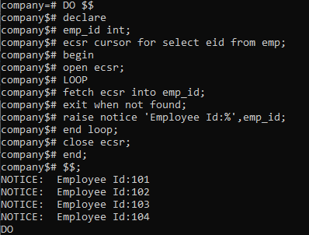
Example:

Slide 45
Stored Functions and Procedures
"A procedures or function is a group or set of SQL statements that perform a
specific task.“
The major difference between a procedure and a function is, a function must always return a value, but a procedure may or may not return a value (in SQL).

Slide 46
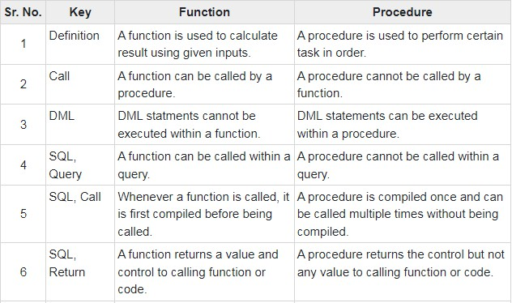
Differences between Function & Procedure.
Following are the important differences between SQL Function and SQL Procedure.

Slide 47
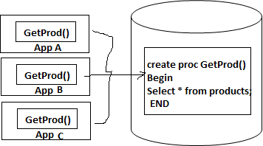
Procedures
A procedure/stored procedure is a named PL/SQL block which performs one or more specific task.
This is similar to a procedure in other programming languages.
Stored procedures can increase productivity by writing once
and using it many times.
A stored procedure has a header and a body.
The header consists of the name of the procedure and the parameters or variables passed to the procedure.
The body consists or declaration section, execution section
and exception section similar to a general PL/SQL Block.

Slide 48
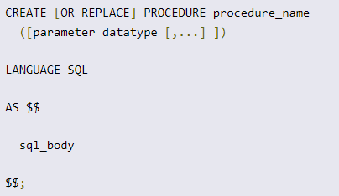
Creating Procedure
OR REPLACE | Optional. CREATE PROCEDURE defines a new procedure. CREATE OR REPLACE PROCEDURE will either create a new procedure, or replace an existing procedure.
procedure_name | Required. Specify the name to assign to this procedure.
parameter | Optional. Specify one or more parameters passed into the procedure.
sql_body | Specify the block of SQL statements to be executed.

Slide 49
To invoke a stored procedure, the CALL statement is used.
Syntax:
CALL procedure_name(parameter(s));

Slide 50
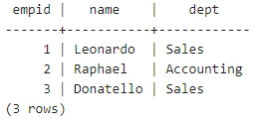
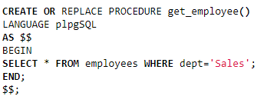
Example
Create a procedure to display record of employees belongs to ‘Sales’ dept.

Slide 51
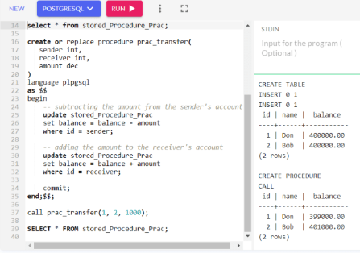
Example 2

Slide 52
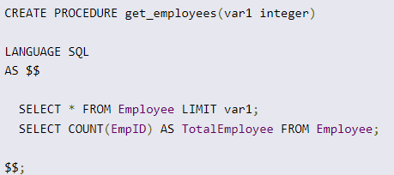
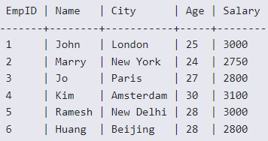

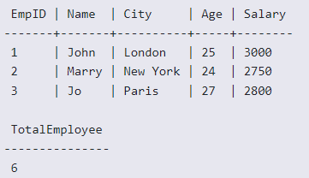
Create Procedure with Parameter

Slide 53
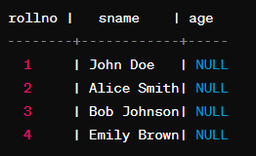
CREATE OR REPLACE FUNCTION update_student_age(student_rollno INT, new_age INT)
RETURNS VOID AS $$
BEGIN
UPDATE student
SET age = new_age
WHERE rollno = student_rollno;
END;
$$ LANGUAGE plpgsql;
Call the procedure:
CALL update_student_age(1, 20);

Slide 54
Stored function

Slide 55
Stored function
A stored function in MySQL is a set of SQL statements that perform some task/operation and return a single value.
The stored function is almost similar to the procedure in MySQL, but it has some differences that are as follows:
The function parameter may contain only the IN parameter but can't allow
specifying this parameter, while the procedure can allow IN, OUT, INOUT parameters.
The stored function can return only a single value defined in the function
header.
The stored function may also be called within SQL statements.
It may not produce a result set.
Thus, we will consider the stored function when our program's
purpose is to compute and return a single value only or create a user-defined function.

Slide 56
Functions in postgresql
The basic syntax to create a function is as follows −
CREATE [OR REPLACE] FUNCTION function_name (arguments)
RETURNS return_datatype
language plpgsql
AS
$variable_name$
declare
-- variable declaration
begin
-- stored procedure body
end; $$

Slide 57
function-name specifies the name of the function.
[OR REPLACE] option allows modifying an existing function.
The function must contain a return statement.
RETURN clause specifies that data type you are going to return from the function.
The return_datatype can be a base, composite, or domain type, or can reference the type of a table column.
function-body contains the executable part.
The AS keyword is used for creating a standalone function.
plpgsql is the name of the language that the function is implemented in.
Here, we use this option for PostgreSQL, it Can be SQL, C, internal, or the name of a user-defined procedural language.
For backward compatibility, the name can be enclosed by single quotes.

Slide 58
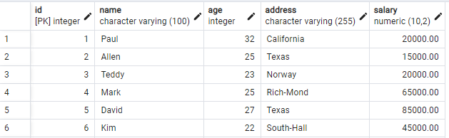
Example
Function totalRecords() is as follows −
Create a function

Slide 59
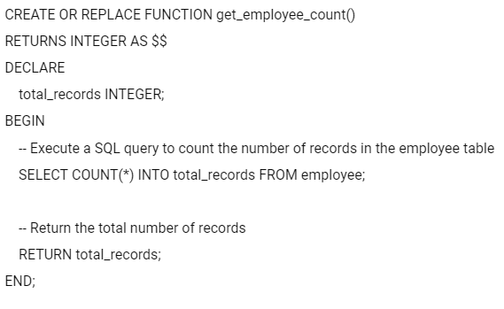

CallIng a function :
select totalRecords();

Slide 60
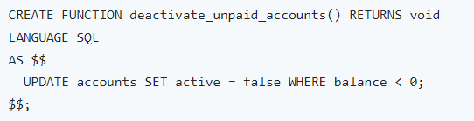


Slide 61
Triggers

Slide 62
Triggers
A trigger is a special type of stored procedure that automatically runs when an event occurs in the database server.
DML triggers run when a user tries to modify data through a data manipulation language (DML) event.
DML events are INSERT, UPDATE, or DELETE statements on a table or view.
These triggers fire when any valid event fires, whether table rows are affected or not.

Slide 63
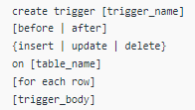
Create Triger syntax:
Explanation of syntax:
create trigger [trigger_name]:
Creates or replaces an existing trigger with the trigger_name.
[before | after]:
This specifies when the trigger will be executed.
{insert | update | delete}:
This specifies the DML operation.
on [table_name]:
This specifies the name of the table associated with the trigger.

Slide 64
[for each row]:
This specifies a row-level trigger, i.e., the trigger will be executed for each row being affected.
[trigger_body]:
This provides the operation to be performed as trigger is fired
BEFORE and AFTER of Trigger:
BEFORE triggers run the trigger action before the triggering statement is run.
AFTER triggers run the trigger action after the triggering statement is run.

Slide 65
For example, before or after the triggering event the OLD and NEW signify the row's states in the table.
How to Create a New Trigger
We will follow the below process to generate a new trigger in PostgreSQL:
Step1: Firstly, we will create a trigger function with the help of the CREATE FUNCTION command.
Step2: Then, we will fix the trigger function to a table with the help of the CREATE TRIGGER command.

Slide 66
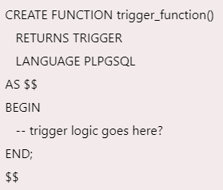
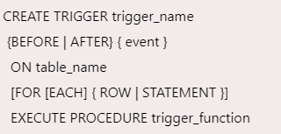
Trigger
Step 1: Syntax of Create trigger function
Step 2: Syntax of Creating trigger

Slide 67
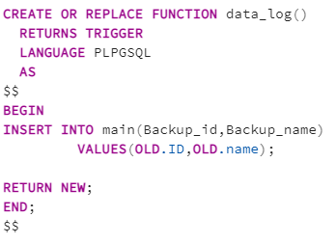
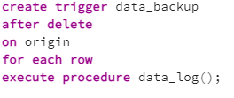
Trigger _function example

Slide 68
Example 2
write a code to implement trigger in postgresql. create table student(id,name,mark1,mark2,total) apply trigger on it, when new row will be inserted into student table total will be calculated automatically. (total=marks1+marks2)

Slide 69
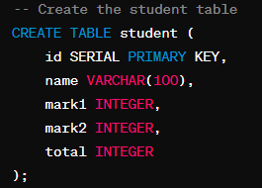
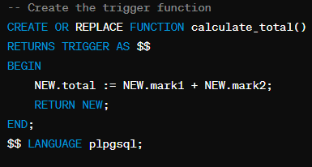
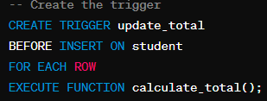

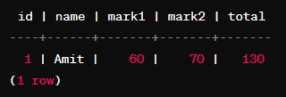


Slide 70
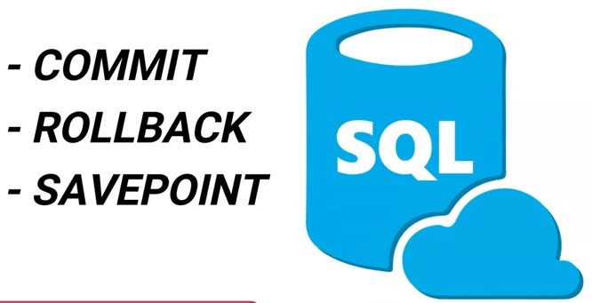
TCL Commands

Slide 71
Transaction Control Languages.
These commands are used for maintaining consistency of the database and for the management of transactions made by the DML commands.
A Transaction is a set of SQL statements that are executed on the data stored in DBMS.
Whenever any transaction is made these transactions are temporarily happen in database.
So to make the changes permanent, we use TCL commands.

Slide 72
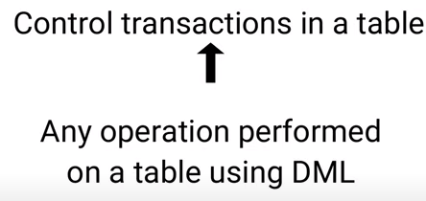
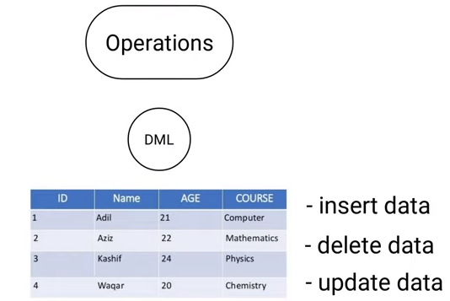
TCL

Slide 73
TCL Commands:
1. COMMIT :
This command is used to save the data permanently.
Whenever we perform any of the DML command like -INSERT, DELETE or UPDATE, these can be rollback if the data is not stored permanently.
So in order to be at the safer side COMMIT command is used.
Syntax: commit;
2. ROLLBACK :
This command is used to get the data or restore the data to the last savepoint or last committed state.
If due to some reasons the data inserted, deleted or updated is not correct, you can rollback the data to a particular savepoint or if savepoint is not done, then to the last committed state.
Syntax: rollback;

Slide 74
3. SAVEPOINT :
This command is used to save the data at a particular point temporarily, so that whenever needed can be rollback to that particular point.
Syntax: Savepoint A;

Slide 75

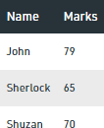
Example:
Consider the following Table Student:
UPDATE STUDENT SET NAME = ‘Sherlock’ WHERE NAME = ‘Jolly’;
COMMIT;
ROLLBACK;
By using this command you can update the record and save it permanently by using COMMIT command.
Now after COMMIT :
If commit was not performed then the changes made by the update command can be rollback.

Slide 76
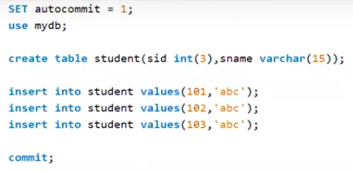



Example:

Slide 77
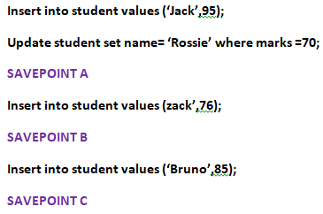


Savepoint
If on the given table savepoint is performed
Now if we Rollback to Savepoint B:
Rollback to B;
The resulting Table will be-

Slide 78

Now if we Rollback to Savepoint A:
Rollback to A;
The resulting Table will be-

Slide 79
Thank you

